Slide 1


Mount Dora
Police Communications
Staff Report

Slide 2
Mount Dora
Police Communications
Staff Report
Economic Recession
2008 the United States entered a severe economic recession
  State and local governments have suffered unprecedented declines in revenues
  Mount Dora has also experienced a decline of income
The City of Mount Dora has systematically examined every provided service to:
  Save money for our residents
  Ensure our residents receive the most cost effective and efficient operations possible
  Maintain a superior level of service for our residents
Outsourcing or consolidation of police communications has become a strategy researched by jurisdictions across the state as a source of budget savings.
In January of 2012, the Mount Dora City Council directed the staff to research the subject and prepare a report on the Mount Dora Police Communications Unit and consolidation options.

Slide 3
Police Communications
Staff Report
Key Points
#1 Public Safety communications is a complex endeavor:
It has far reaching implications for the agencies involved as well as for the daily lives of the citizens within its jurisdiction,
A police department communications unit is often considered the nerve center of the agency. It provides the citizens with an immediate and direct link to their first responders as well as a 24/7 access point for general government,
It is no longer a simple matter of answering the phone and radioing directions to a police officer, and
Police department communication units not only provide its internal customers (police department employees) with a wide array of services but it also provides its external customers (residents and visitors) a broad range of services. Some services are immediately recognizable but many are not as readily apparent. This report will review as many as possible.

Slide 4
Police Communications
Staff Report
Key Points
#2 CONSOLIDATION OF SERVICES IS NOT A NEW CONCEPT.
Police administrators routinely evaluate how and where shared services are the most cost effective.
In difficult financial times, the challenge is especially acute due to struggles caused by reductions in both personnel and budget.
The Mount Dora Police Department regularly works closely with our regional law enforcement partners (federal, state, and local) to address problems that are not cost effective to work independently.
The goal is to sustain services at the level our community finds acceptable.

Slide 5
Public Safety
Communication Centers
Four Options
    Maintain current services
    Outsource to a third party
    Consolidate among municipalities
    Consolidate as a region

Slide 6
Public Safety
Communication Centers
Consolidation Vs Outsourcing
  Outsourcing means contracting for a service with an outside entity
  Consolidation means joining efforts into a unified/joint operation
  Commonly used as interchangeable terms but have very different outcomes
Regardless, every option has been researched by the Mount Dora Police Department staff and will be presented.
The strengths and weaknesses of each alternative have been reviewed and potential directions for the future offered.

Slide 7
Mount Dora Police Communications Unit
Five Components of Communications
        Personnel
        Facility
        Technology
        Services
        Budget

Slide 8
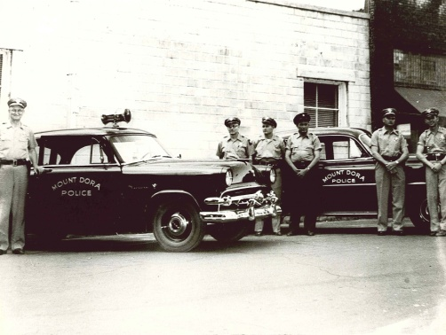
Mount Dora Police Communications Unit
Brief History
Mount Dora Police Department has operated a communications office throughout its entire history.

Slide 9
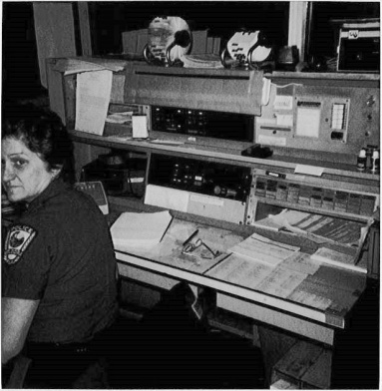
Mount Dora Police Communications Unit
Prior to 2000, a single dispatcher staffed the communications office through a combination of sworn and civilian employees. Police officers would supplement as needed.

Slide 10
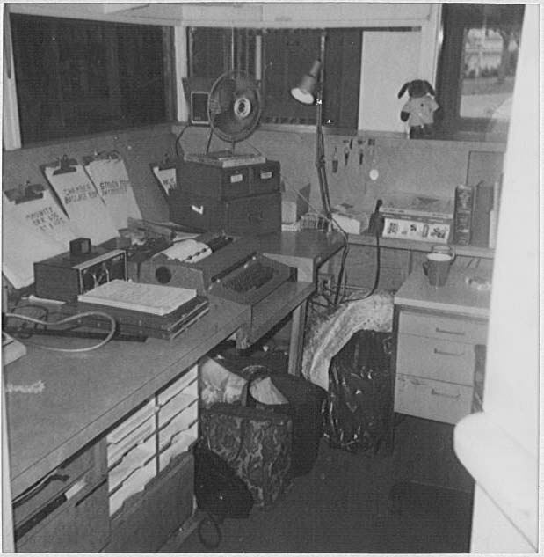
Mount Dora Police Communications Unit
The communications office was located in a small office fronting the lobby. Technology was limited to telephones, typewriter, and a radio. No inter-agency operability was available except with the sheriff.

Slide 11
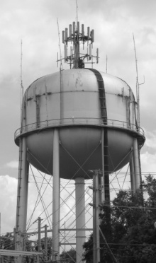
Mount Dora Police Communications Unit
Up to the 1980s – city owned, stand-alone radio system with its own low band VHF frequency
1988 – Switched to high band VHF and moved antenna to water tower
1988 – City became part of county 911 system
1990s – USA software was acquired for computer aided dispatch (CAD) , report writing, and records management
2000 – MDPD began modernizing, two new digital consoles, updated software
2001 – Expanded staffing to ensure 2 dispatchers were on duty
2004 – State Accreditation
2006 – Building renovation and expansion. Communications was a key part of the design and improvements

Slide 12
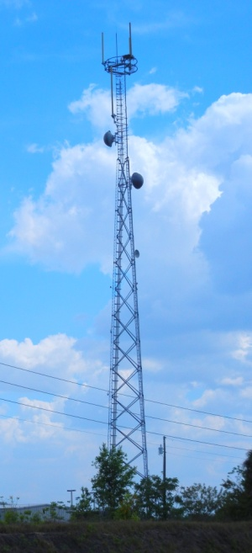
Mount Dora Police Communications Unit
2007 – USA computer operating software was significantly upgraded and enhanced with greater capabilities: CAD, report writing, high speed communications with MCTs, crash reporting with DHSMV.
2009 – MDPD became part of new county-wide 700/800 MHz radio system.
  State-of-the-art
  All digital technology
  Built to nationally accepted standards
  All Lake County first responders have full inter-operability with each other and any other local or national 700/800 MHz system.
2010 – Motorola re-engineered our radio “consoles” to enhance their information gathering, display, and channel grouping

Slide 13
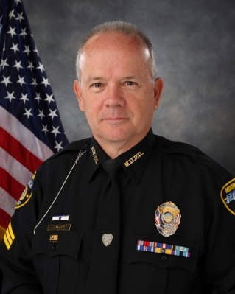
Mount Dora Police Communications Part 1 – Personnel
Lieutenant Bruce W. Clark
20 year veteran of law enforcement
27 years administrative experience
Doctoral Degree
Multiple awards, MDPD as well as outside agencies
2010 Florida Accreditation Manager of the Year
2011 Lifetime Achievement Award from the American Society of Industrial Safety Professionals
State certified law enforcement instructor

Slide 14
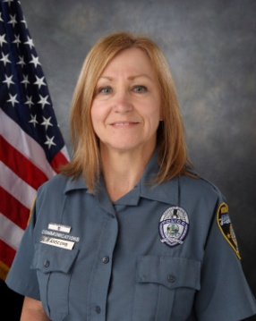
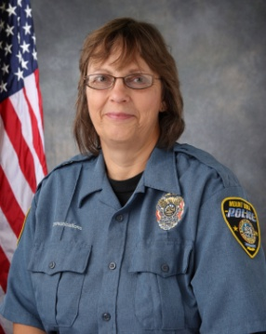
Mount Dora Police Communications Officers
Paula Anscomb
7 years experience (Mount Dora)
CTEP Trainer
State Certified Telecommunications Officer
Certified FCIC/NCIC/DAVID
Communications Training Officer
Sheila Baker
24 years police officer, current reserve officer
34 years dispatcher experience (Tavares and Mount Dora)
12 years dispatcher Mount Dora
State Certified Telecommunications Officer
Specialized training: FTO, SRO, THI
Mount Dora resident 24 years

Slide 15

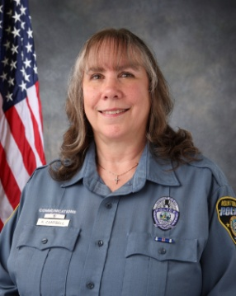
Mount Dora Police Communication Officers
Sandra Bryan
7 years dispatcher experience (Mount Dora)
32 year career in United States Navy
Retired Command Master Chief
Education/Training: Graduate of U of Maryland, Seina Heights College, US Naval War College, Recruit Company Commander, qualified Military Corrections Officer
State Certified Telecommunications Officer
Mount Dora property owner
Karan Campbell
10 years dispatcher experience (Fire and Mount Dora)
Education/training: Critical Incident Stress Management, Fire Safety classes, Code Enforcement, Medical, Firefighter 1 course, IS100 & IS700 NIMS classes,
Certified FCIC/NCIC/DAVID
State Certified Telecommunications Officer

Slide 16
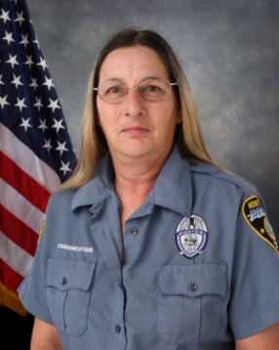
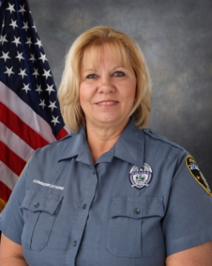
Mount Dora Police Communication Officers
Bonnie Clark-Davis
15 years dispatcher experience (Tavares and Mount Dora)
Education/Training: Firefighter/first responder, CPR, APCO/CTO, 911 certified,
FCIC/NCICDAVID certified.
Communications Training Officer
State Certified Telecommunications Officer
Mount Dora resident for 28 years
Sharon Kemp
Lead Dispatcher
27 years total dispatcher experience (Lake County Sheriff’s Office, Sumter County, Clermont, Cocoa)
11 years experience in Mount Dora
Education/Training: , Georgia Police Academy 911 Dispatcher graduate, APCO, 911, LAI,
Communications Training Officer
FCIC/NCIC/DAVID certified

Slide 17
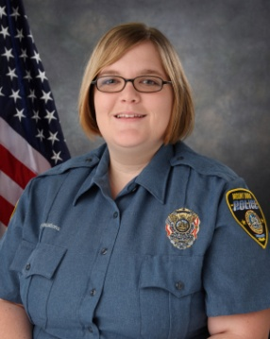
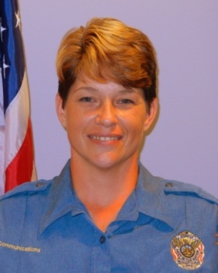
Mount Dora Police Communication Officers
Heather Morris
6 years dispatcher experience
1 year Orlando International
5 years in Mount Dora
Emergency Medical Dispatch certified / CPR
FCIC/NCIC/DAVID certified
State Certified Telecommunications Officer
Jennifer Vaughn
Newest dispatcher
Hired 2011 (Mount Dora)
FCIC/NCIC/DAVID certified
4 years commercial dispatch experience

Slide 18








Mount Dora Police Communication Officers
107 years of Cumulative Experience
Mount Dora dispatchers:
  Institutional knowledge of the city, geography, and landmarks
  Informed on city events
  Knowledge of the police officers, other city employees, and many of the citizens and business owners
  Know the locations and people with chronic medical conditions, mental disorders, frequent complaints, and high risk suspects
  City ordinances and priorities
  Department policy and procedures

Slide 19
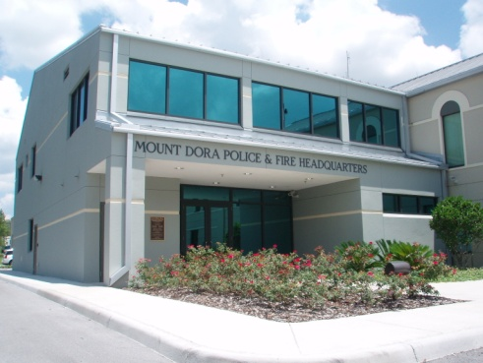
Mount Dora Police Communications Part 2 - Facility
Police and Fire Headquarters Building
2006 – Renovated and expanded
4 + million dollar project
Higher standards for terrorism and hurricanes
Additional space and safety
Dramatically improved efficiency and effectiveness

Slide 20
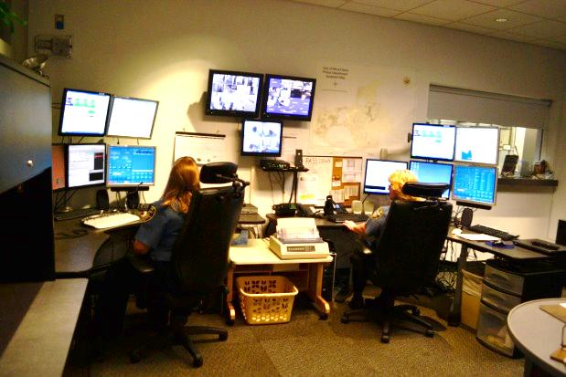
Mount Dora Police Communications Part 2- Facility
Designed “Ground up” as a Comm Center
Hardened throughout
Poured concrete envelope
Ballistic glass & Steel doors
  Secured within secure facility
  Totally self-contained: bathroom, lockers, kitchen
Redundant power systems
  Main generator
  UPS battery back-up
  Rapid connection to mobile generator

Slide 21
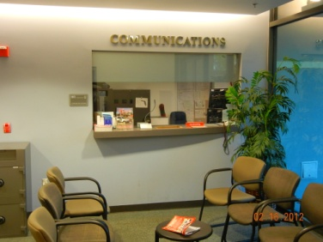
Mount Dora Police Communications Part 2 - Facility
Located on ground floor of Police and Fire Headquarters Building
24/7 public access

Slide 22
Mount Dora Police
Communications Part 3 - Technology
911 PSAP (Public Safety Access Point)
  911 center for police, fire, and medical emergencies
  Equipment is new
  911 funds help pay for all 911 related expenses including:
    phone service
    data software
    Computers
    Back-up power system
    Furniture
    Training
  Specially designed furniture for 911 PSAP’s

Slide 23
Mount Dora Police
Communications Part 3 - Technology
  Radio system
    County-wide 700/800 MHz based Motorola trunking system
      18 tower sites providing near 100% coverage
      Lake County is responsible for all maintenance, upkeep, and computer system upgrades
    Full compatibility and interoperability: local, state and national
    Every officer issued a portable radio
    Every vehicle equipped with a mounted radio
    Mount Dora is assigned 10 talk groups (channels)
    Two dispatch work stations with full radio function

Slide 24
Mount Dora Police
Communications Part 3 - Technology
  Fully integrated CAD, reporting, and records management software
  Able to accommodate additional staff during disaster operations
  Centrally located near the City Emergency Operations Center (EOC) at the Police and Fire Headquarters Building
  Specially designed computer room flooring so that all electrical and other cabling is under the floor
  Secure computer equipment room with its own HVAC system
  NCIC/FCIS/DAVID Computers
  Secure equipment closet for all building security electronics
  Additional interior security door in case of building breach

Slide 25
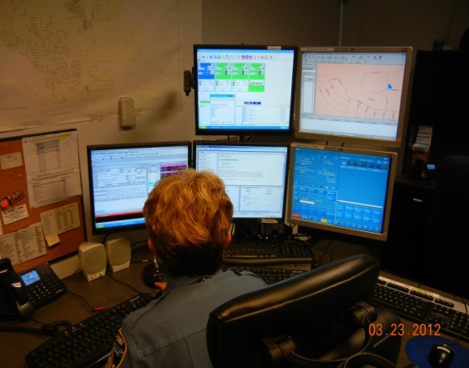
Mount Dora Police Communications Part 4 - Services
Traditional Police Dispatch Services
Answer all 911 calls, police, fire, medical
  2000 – average 3600 per year
  2011 – average 5500 per year
Answer 6 non-emergency phone lines
  26,000 – external inbound
  7,300 - internal inbound
  8,000 - outbound
Calls for service dispatched
  2000 – average 17,500 per year
  2010 – average 25,000 calls per year
  2011 – 29,226 including:
  5000-6000 officer initiated traffic stops
  1000s of Officer well-being checks

Slide 26
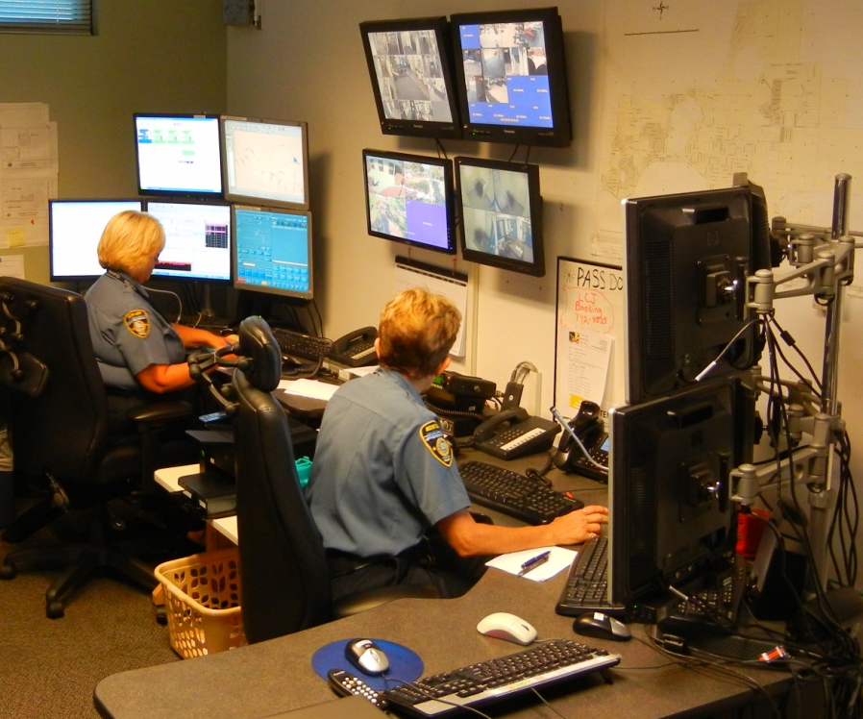
Mount Dora Police Communications Part 4 - Services
Traditional Police Dispatch Services
  FCIC/NCIC and local data bases for warrants and advisories
  DAVID for driver license status
  DHSMV for vehicle tags
  Administrative assistance to patrol officers: phone calls, notifications, warrant confirmations, checking maps, etc.
  FCIC/NCIC entry of stolen/lost property including vehicles and firearms
  Tracking repossessions and tow logs
  Activations of Silver and Amber Alerts
  Emergency notifications including: detectives, traffic homicide investigators, chaplains, chain of command personnel, command staff, and evidence technicians

Slide 27
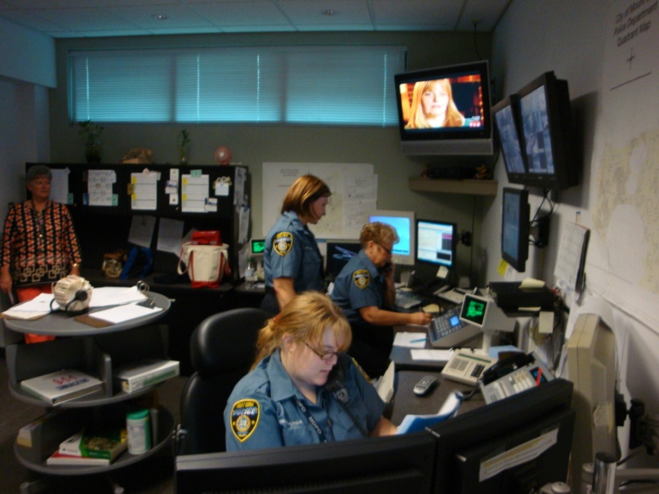
  Mount Dora Police Communications Part 4 – Services
  Additional Responsibilities of MDPD Communications
  Administrative assistance to patrol officers:
    Report research, phone calls, notifications, checking maps, copying, faxing, building maintenance, etc.
  Tracking false alarm calls
  Noise ordinance warning and citation records
  Dust control ordinance
  Trespass warnings and violation log
  Filing injunctions, garage sale permits
  Extra watch coordination (residents on vacation, out of town, etc.)
  Lost and found coordination (pets are common)
  Bicycle Registration coordination (weekends & holidays)
  Animal control complaints

Slide 28
Mount Dora Police Communications Part 4 - Services
Additional Responsibilities of MDPD Communications
Walk-in service
  2000 citizen walk-ins per year
Parks and recreation facility sign out and return of keys
Utility payments and weekend turn-on service
Utility trouble reporting and weekend dispatching - 24/7
Data capturing and retrieval through CAD including:
  Routine complaint information
  Patrol activity
  Call and Crime patterns
  Response time analysis
  Immediate Complaint Call retrieval and copying
  Traffic stop profiling data

Slide 29
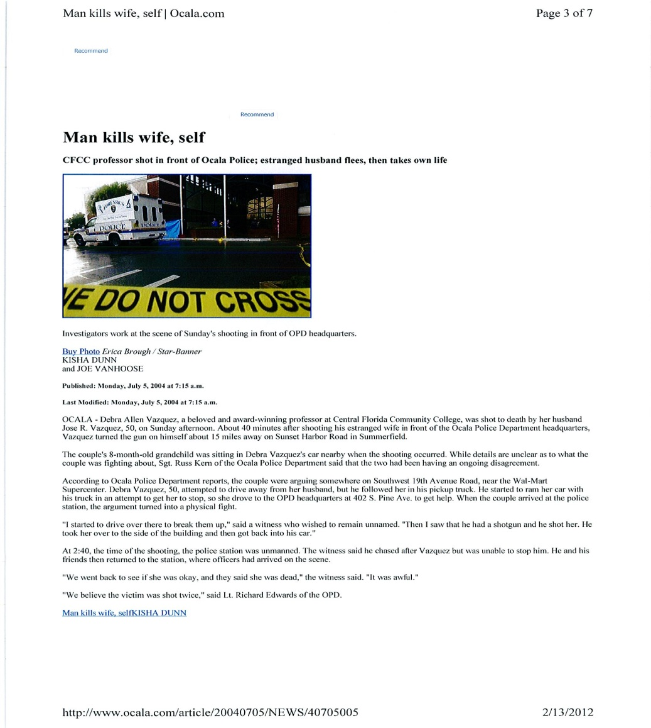
Mount Dora Police Communications Part 4 - Services
Additional Responsibilities of MDPD Communications
Safety Refuge
Domestic Violence
“Safeplace” Infant drop

Slide 30
Mount Dora Police Communications Part 4 - Services
Additional Responsibilities of MDPD Communications
Help desk and city switchboard
  Only “live” person in city available 24/7
  Access to Police and Fire Departmental personnel
  Routine community inquiries and questions
  Special event questions
  Visitor information
  Directions
  Storm information
  Traffic and street closures
  Senior citizen outreach

Slide 31
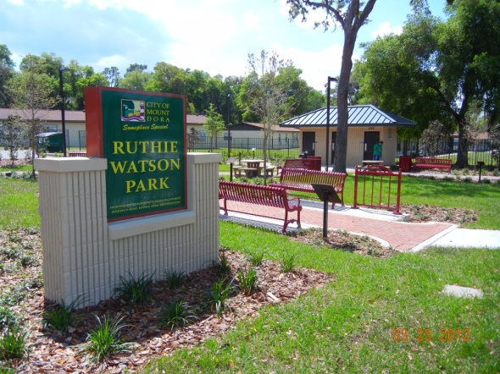
Mount Dora Police Communications Part 4 - Services
Additional Responsibilities of MDPD Communications
  Ruthie Watson Park video monitoring
  City building alarm monitoring
    Library
    City Hall
    City annex
    Community Building
    Property/Evidence building
    MLK Center
    CareHere
    Donnelly Park Building

Slide 32
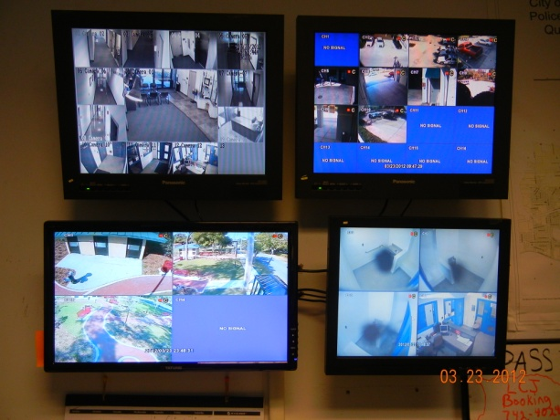
Mount Dora Police Communications Part 4 - Services
Additional Responsibilities of MDPD Communications
    Video monitoring of entire building and parking lots
    Computer controlled building access system
    All outside doors
    Critical inside doors
    Control parking lot gates
    Control and monitor prisoner Sallyport gates for MDPD and outside agencies
  Police Building Security

Slide 33
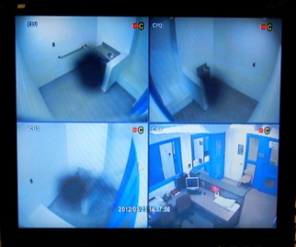
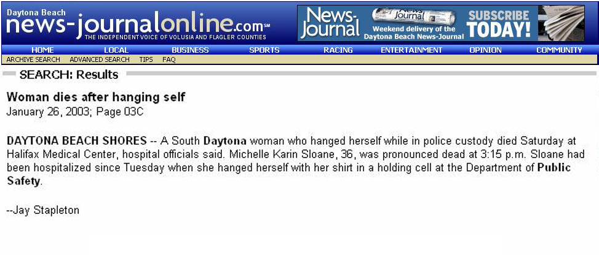
Mount Dora Police Communications Part 4 - Services
Additional Responsibilities of MDPD Communications
Holding Cell Monitoring:
Juvenile, Adults, and Female Prisoners

Slide 34
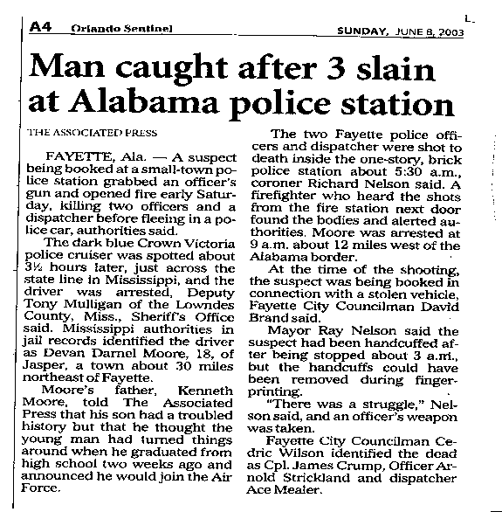
Mount Dora Police Communication Unit Services
Additional Responsibilities of MDPD Communications
High Risk Area Monitoring
Sallyport
Security Vestibule
Booking Office
DUI processing
All Hallways

Slide 35
Mount Dora Police
Communications Part 5 - Budget
Five Years
Mount Dora Police Department Communications Budgets 2007- 2011
2007 | 2008 | 2009 | 2010 | 2011
364,513 | 345,498 | 390,791 | 394,600 | 399,300

Slide 36
Public Safety
Communication Centers
Comparable Cities
            Tavares
            Maitland
            Clermont
            Eustis

Slide 37

Communication Services
Other Agencies
Tavares Police Department
2001 outsourced to LCSO to save money
  As a result:
  City Hall was left unlocked so phone to dispatch was available
  No Staffing was at Police Department
2002 TPD became unhappy in the reduction of service level
2005 City council member found a domestic violence victim in lobby
2006 City council grew increasingly concerned over lack of staffing at TPD and voted to reinstate their communications. Their goal was to:
  Improve the level of services for all residents
  Improve the safety and efficiency of the Police Officers
  Improve the communications for other city departments
  Improve security for city buildings and infrastructure
  Allow residents to obtain help from city hall at all times

Slide 38
Communication Services
Other Agencies
Tavares Police Department
Eight (8) fulltime and several part time dispatchers to ensure two (2) are on duty at all times.
2010 Tavares Staff Report:
“Since the reimplementation of the Communications Center, the Police Department has dramatically improved its response time, accountability, officer safety, and greater citizen access.”
Tavares Police Department Communications Budgets 2007- 2011
2007 | 2008 | 2009 | 2010 | 2011
690,824 | 573,160 | 556,286 | 496,385 | 468,234

Slide 39

Communication Services
Other Agencies
Maitland Police Department
Mid 1990s outsourced communications to Apopka PD
  To save money
  To avoid a 2.4 million dollar renovation and update
Chief of Police Ed Doyle researched outsourcing to:
  Orlando
  Orange County
  Apopka
Apopka was the low bidder
  Assured Maitland they would provide same service
  Commitment was honest and genuine

Slide 40
Communication Services
Other Agencies
Chief Doyle – retired 2003 – 30 year career
  Apopka, despite good intentions, could not provide same level of service
  “Worst mistake” of his career
  “To this day, I am ashamed that our level of service to those counting on it was diminished”
  Maitland is still living with “well-intended bad decision”
    Lack of local knowledge
    Loss of identity
    Impersonal service
    Delays in responsiveness
    PD was locked
    Call box outside

Slide 41
Communication Services
Other Agencies
Maitland Police Department - 2012
Chief of Police – Doug Ball
Apopka is providing professional service, however
  Maitland is still struggling with the organizational and structural limitations
  Chief Ball reports:
    There is a “tremendous” loss of service to their residents
    No one staffs the police department after business hours
    The Apopka dispatch has little to no local knowledge of Maitland
    Citizen complaints are weekly
    The CAD system of Apopka is totally incompatible with Maitland’s reporting and records management software. There is no integration or interface. Because of the software difference, there is a potential for:
      loss of information
      reporting inefficiency
      increased liability through miscommunication

Slide 42
Communication Services
Other Agencies
Maitland Police Department
Software Issues
  Apopka CAD
  Incompatible with Maitland reporting and records management system
  The cost, time and staff effort to match Apopka’s software will be enormous.
Contract has an automatic 5.5% increase per year
Maitland PD would like to re-implement their own communications unit, but cost is prohibitive
Maitland Police Department Communications Contract 2011-2015
2011 | 2012 | 2013 | 2014 | 2015
372,475 | 393,000 | 414,600 | 437,400 | 461,400

Slide 43

Communication Services
Other Agencies
Clermont Police Department
2010 outsourced to LCSO
  To save money
  Improve communications effectiveness
As a result
  Police Station is locked everyday at 6:30pm
  Call box is located outside
  There is no staffing at police station
  Clermont terminated all 11 dispatchers
  Note: LCSO did not hire any of the terminated dispatchers

Slide 44
Communication Services
Other Agencies
Clermont Police Department
Five year contract
  $396,426 annually, either party can request to renegotiate
Equipment and furniture, one time outlay
Equipment , annual payment
LCSO uses Spillman Computer Aided Dispatch (CAD) software
Clermont had to buy Spillman operating software
  Report writing
  Records Management
  Traffic crashes
Data records conversion
  USA, New World, Spillman to access archived records

Slide 45
Communication Services
Other Agencies
Clermont Police Department
Clermont outsourcing costs:
  $396,426 (annual for salaries and benefits)
  $102,713 one-time payment for equipment
  $19,626 annual payment for equipment
  $310,600 for software change
  $34,825 annual maintenance for software
  Cost to maintain 2 additional RMS (unreported)
  Employee accrual pay outs (unreported)
  Unemployment expenses (unreported)
First year costs: $809,739 + unreported
Recurring yearly expense: $450,877

Slide 46

Communication Services
Other Agencies
Eustis Police Department
Chief of Police - Fred Cobb
Eustis Communications Unit
  8 fulltime, 1 part time
  2 on duty at all times
  24/7 police station staffing
  Monitor lobby via camera
  Safety refuge
Chief Cobb has researched outsourcing and has determined the loss of service and management oversight outweigh any potential savings
  Provides a great value to community
  Knowledge of city and of potential problems
  Described as “force multipliers”
Eustis Police Department Communications Budgets 2007- 2011
2007 | 2008 | 2009 | 2010 | 2011
417,967 | 437,276 | 440,427 | 467,242 | 479,998

Slide 47
Communication Services
Agency Budgets
Five City Comparison
Tavares, Maitland, and Clermont outsourced their communications to save money. Mount Dora and Eustis have not outsourced. All five agencies incur approximately the same cost for communications when adjusted for individual agency budgeting and organizational structures.
2012
Maitland $393.000
Mount Dora $399,600
Clermont $450,887
Tavares $468,234
Eustis $479,998

Slide 48
Communication Services
Agency Comparisons
Communication Officers Pay Comparisons
Mount Dora Police Department
Entry pay $25,753
Top pay $33,310
Average pay $29,466
Tavares Police Department
Entry pay $26,250
Top pay $45,750
Average pay $35,360
Eustis Police Department
Entry pay $26,598
Top pay $37,544
Average pay $30,815
Lake County Sheriff’s Office
Call Taker $21,964
Teletype operator $24,377
Entry pay dispatcher $27,060
Top pay dispatcher $40,073
Groveland Police Department
Entry Pay $27,768
Top Pay $41,329
Leesburg Police Department
Entry Pay $26,603
Top Pay $39,478
Lady Lake Police Department
Entry Pay $27,081
Top Pay $40,705
City of Apopka
Entry Pay $35,235
Top Pay $55,161

Slide 49
Communication Services
Outsourcing
Two Options for Outsourcing
  Lake County Sheriff’s Office
  Another Municipality
Lake County Sheriff’s Office
  Howey-in-the-Hills No cost
  Umatilla No cost
  Astatula No Cost
  Fruitland Park No cost
  Mascotte No Cost
  Minneola No cost
  Tavares (2001-2006) $186,000
  Tavares (2010 proposal) $247,766 + $141,635 equipment (5 dispatchers)
  Clermont $450,877

Slide 50
Communication Services
Outsourcing
Advantages:
  Potential long term savings:
    If a reduction in service to the level of traditional police dispatching is acceptable
  Improved effectiveness:
    If the existing communications unit is underperforming

Slide 51
Outsourcing
Communication Services
Disadvantages:
  Transitions costs
  Potential for increased future operating costs
  Reduced services
    Residents
    Officers
    Other city departments
  No direct oversight over quality and performance
  No management control over software and technology upgrades
  Police station safety compromised for officers, residents
  Increased potential for miscommunication between officers and dispatchers

Slide 52
Outsourcing
Communication Services
Disadvantages:
Because of the scale and complexity of communications: outsourcing becomes a nearly irrevocable decision
Enormous investment of time, effort, and money:
  Infrastructure
  Computers, software, and equipment
  Personnel recruiting and training
  Organizational knowledge and experience

Slide 53
Outsourcing
Communication Services
Mount Dora Cost to Outsource:
  $349,657 annual contract
  $102,713 one-time payment for equipment
  $10,626 annual payment for equipment
  $310,600 for software change
  $9,600 overtime expenses for training employees on new software
  $34,825 annual maintenance for software
  $50,000 - $100,000 (est.) for records conversion to new software
  $12,677 Severance pay
  $37,810 Accrual pay outs,(comp, vacation, sick time)
  $0 - $173,800 Liability for unemployment expenses
        First year expense: $918,508
    Liabilities
      Additional Software conversion $50,000
      Unemployment $173,800
        Potential Total $1,142,308
        Recurring annual expense $360,283

Slide 54
Outsourcing
Communication Services
Cost to Replace Other Services:
  Additional staff for police station to stay open 24/7:
  Duplicate or relocate technology/monitoring equipment in dispatch office to records office
    $10,000 - $20,000 (approx.)
Hire 3 employees
$27,000 salary each, plus benefits
$110,000 annual

Slide 55
Communication Services
Consolidation w/ municipalities
Consolidation: join operations and mutually operate with equal authority
Outsourcing: contracting out the service
Challenges:
  Finding city(s) to participate
  Creating a new legal entity
  Establishing governing bylaws
  Naming a governing board
  Determining management oversight
  Building a Facility
  Settling on operating software
  Determining scope of services
  Staffing
  Developing rules, policy and procedures, protocols
  Transition costs

Slide 56
Communication Services
Consolidation w/ municipalities
Advantages:
Economy of Scale
Control
  Budget
  Policies and procedures
  Services provided
  Personnel
  Quality
  Responsiveness
  Accountability

Slide 57
Communication Services
Consolidation w/municipalities
Weaknesses:
Consolidation Costs:
  Legal expenses of creating an entity, agreements, etc.
  Liability, indemnities, insurance, etc.
  Establishing a Governing Board
  Building a Facility
  Hardware expenses
  Software conversion and expenses
Loss of police station staffing
Loss of individual jurisdiction services

Slide 58
Communication Services
Regional Consolidation
  Mascotte
  Minneola
  Clermont
  Fruitland Park
  Astatula
  Howey-in the-Hills
  Umatilla
  Mount Dora
  Tavares
  Eustis
  Lady Lake
  Groveland
  Leesburg
  LCSO

Slide 59
Communication Services
Regional Consolidation
Regional Consolidation
All 13 cities, police, fire, EMS and Sheriff form an authority or consortium to jointly operate public safety communications.
The new Lake County Public Safety Communications Office would be governed by a board comprised of representatives of every agency.
The board would hire an executive director and staff.
Funding could be provided by Lake County similar to the new radio system, or could be formulated by agreement by all entities.
Every agency would maintain an interest in the most effective and cost efficient operation.
Policy and procedures, operations, staffing and protocols would all be standardized.

Slide 60
Communication Services
Regional Consolidation
Regional Consolidation Challenges:
  Creating a new legal entity
  Establishing governing bylaws
  Naming a governing board
  Determining executive director/management oversight
  Building a facility
  Purchasing all equipment
  Settling on operating software
  Determining scope of services
  Staffing
  Developing rules, policy and procedures, protocols
  Transition costs

Slide 61
Communication Services
Regional Consolidation
Advantages:
Economy of Scale
Control
  Budget
  Policies and procedures
  Services provided
  Personnel
  Quality
  Responsiveness
  Accountability

Slide 62
Communication Services
Regional Consolidation
Weaknesses:
Consolidation Costs:
  Legal expenses of creating an entity, agreements, etc.
  Liability, indemnities, insurance, etc.
  Establishing a governing board
  Building a facility
  Hardware expenses
  Software conversion and expenses
Loss of police station staffing
Loss of individual jurisdiction services

Slide 63
Public Safety
Communication Centers
The Police Chief, March 2012
Charles J. Kocher, EdD, Deputy Chief of Police (Retired), Camden, New Jersey in “Sustaining Police Operations at an Efficient and Effective Level under Difficult Economic Times”
“In the final analysis, will shared services or consolidation of law enforcement services actually enhance the delivery of efficient and effective operations to better serve the community, or will services become watered down and impersonal?”
,

Slide 64
Mount Dora
Police Communication Services
Mount Dora Communications
Lake County
Sheriff’s Office Proposal
$399,300
  $349,657 (annual for salaries and benefits)
  $102,713 One-time payment for equipment
  $10,626 Annual payment for equipment
  Transition costs
  $310,600 Software change
  $ 9,600 Training overtime
  $34,825 Annual maintenance for software
  $50,000 Cost to convert records mgmt system
  $12,677 Severance pay
  $37,810 Employee accrual pay outs
  $0-174,000 Unemployment expenses
  Total First year: $918,508
  Potential Total: $1,142,308

