Slide 1



Juvenile Reentry Programs Palm Beach County
Rodrick White, Palm Beach County Sheriff’s Office
Tamara Starks, Palm Beach County Sherriff’s Office
Shahzia Jackson, Palm Beach County Criminal Justice Commission

Slide 2
Based on a study of 42 juveniles (2012):
*Recidivism rate in PBC is 50% (re-arrest) for juveniles
33% had a mental health illness
31% were on psychotropic medication at some point
24% gang involved
5% in foster care
Data Source: 2012 study of Palm Beach County juveniles returning home from commitment and county jail done by the University of Miami
*currently working on adjudication/conviction recidivism rate

Slide 3

What is Reentry???
“Reentry refers to the transition of offenders from prisons or jails back into the community”
Bureau of Justice Assistance: Center for Program Evaluation and Performance Measurement

Slide 4
What works?
Principle 1: Base supervision, service, and resource-allocation decisions on the results of validated risk and needs assessments.
Principle 2: Adopt and effectively implement programs and services demonstrated to reduce recidivism and improve other youth outcomes, and use data to evaluate system performance and direct system improvements.
Principle 3: Employ a coordinated approach across service systems to address youth’s needs.
Principle 4: Tailor system policies, programs, and supervision to reflect the distinct developmental needs of adolescents.
Core Principles for Reducing Recidivism and Improving Other Outcomes for Youth in The Juvenile Justice System , Council of State Governments

Slide 5
What Works?
Objective assessment of criminogenic risk and needs
Engage in practice that enhances intrinsic motivation in offenders
Target “higher-risk” offenders
Address offenders greatest criminogenic needs
Use cognitive-behavioral interventions
Determine dosage and intensity of services

Slide 6

Best Practices
Cognitive interventions (Thinking for A Change, Aggression Replacement)
Motivational Interviewing

Slide 7

Juvenile Reentry Subcommittee

Slide 8
Reentry Taskforce

Slide 9
Mission
“Reduce recidivism and promote public safety by implementing a coordinated and comprehensive individualized transition plan for each youth based on his or her risks, needs, and strengths. Agencies from the juvenile justice and social services systems will collaborate to design a client-centered, trauma-informed reentry planning process using traditional and nontraditional resources driven by an evidence-based assessment tool, focusing on an individualized transition plan from the time of the youth’s commitment to out-of-home placement through the period of incarceration, to the periods of transition, reintegration, and aftercare in the community.”

Slide 10
Palm Beach County Sherriff's Office
Juvenile Programs

Slide 11
Juvenile Inmate Programs
Faith-based
Education
Reentry

Slide 12

Inmate Transition
Education Transition Meetings
Youth meets providers
Transition Planning

Slide 13
Connecting youth to community
Back to A Future Initiative

Slide 14
Back to A Future
Began in early 2014
Funded by OJJDP
BTAF is a Palm Beach County Initiative for juveniles returning home from commitment and County Jail
Eligibility: Under 18 at enrollment, assessed as mod-high risk, and returning home from residential commitment or County Jail
Developed by the Juvenile Reentry Subcommittee

Slide 15
BTAF Partners
University of Miami
Department of Juvenile Justice
Palm Beach County Sheriff’s Office
Gulfstream Goodwill
Choice to Change
The Lord’s Place
Palm Beach County School District

Slide 16
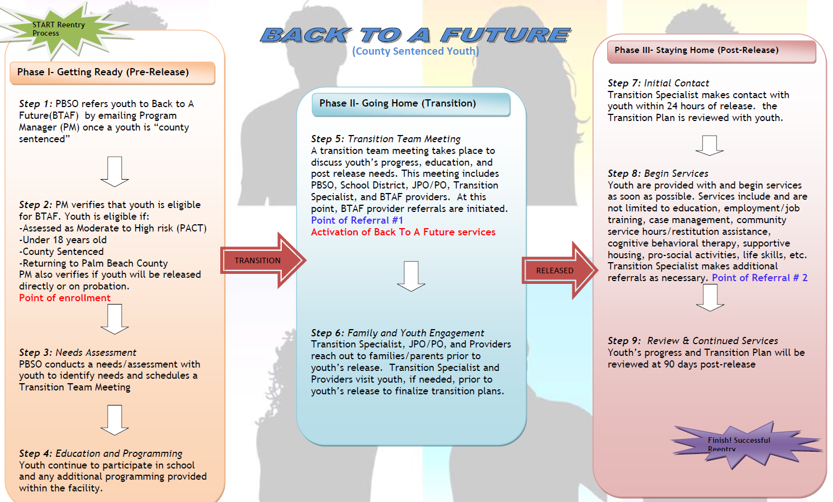

Slide 17
Criminogenic Needs
Antisocial behaviors, patterns, cognition, and peers
Aggression Replacement Training
Life Skills
Family
Family Intervention Choice to Change 102
School/Work
Job readiness, GED, Vocational school, education assistance
Leisure/Recreation
Pro-social activities
Substance abuse/Mental Health
Mental health and/or substance abuse counseling
Support groups

Slide 18
Other services
Case management
Restitution & community service
And other individual needs
New! Reentry Hearings
New! Mentoring

Slide 19
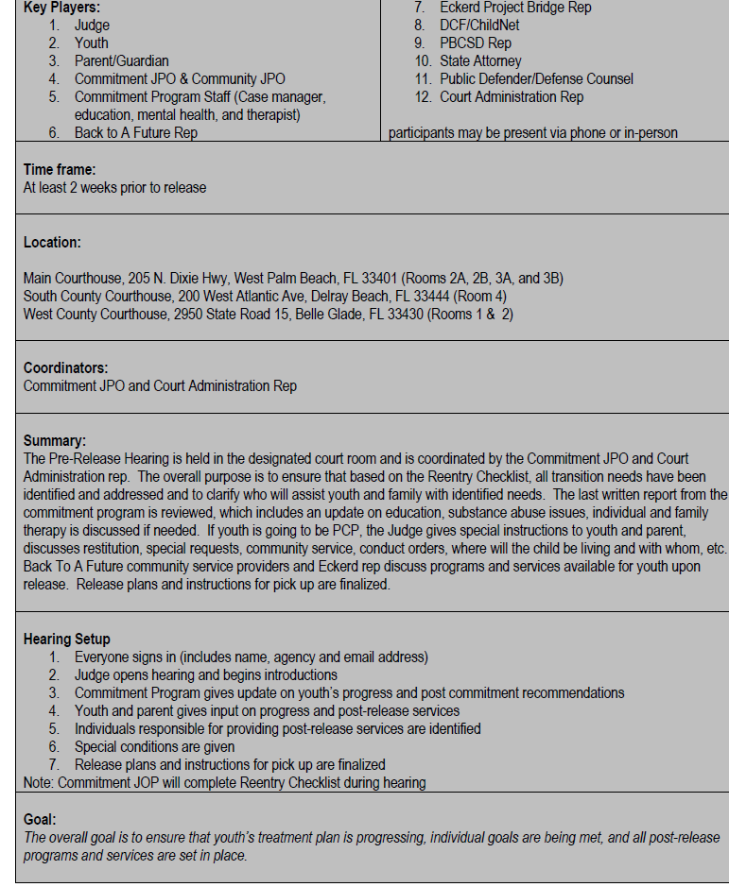
Reentry Pre-Release Hearing

Slide 20
Statistics
To date:
96 juveniles served
25 re-arrests
26% re-arrest recidivism rate
78 are in school and/or employed

Slide 21
Challenges in Juvenile Reentry
Systems resistant to change
Funding
Linking juveniles to appropriate treatment
Lack of family support
Lack of appropriate educational and/or vocational settings

Slide 22
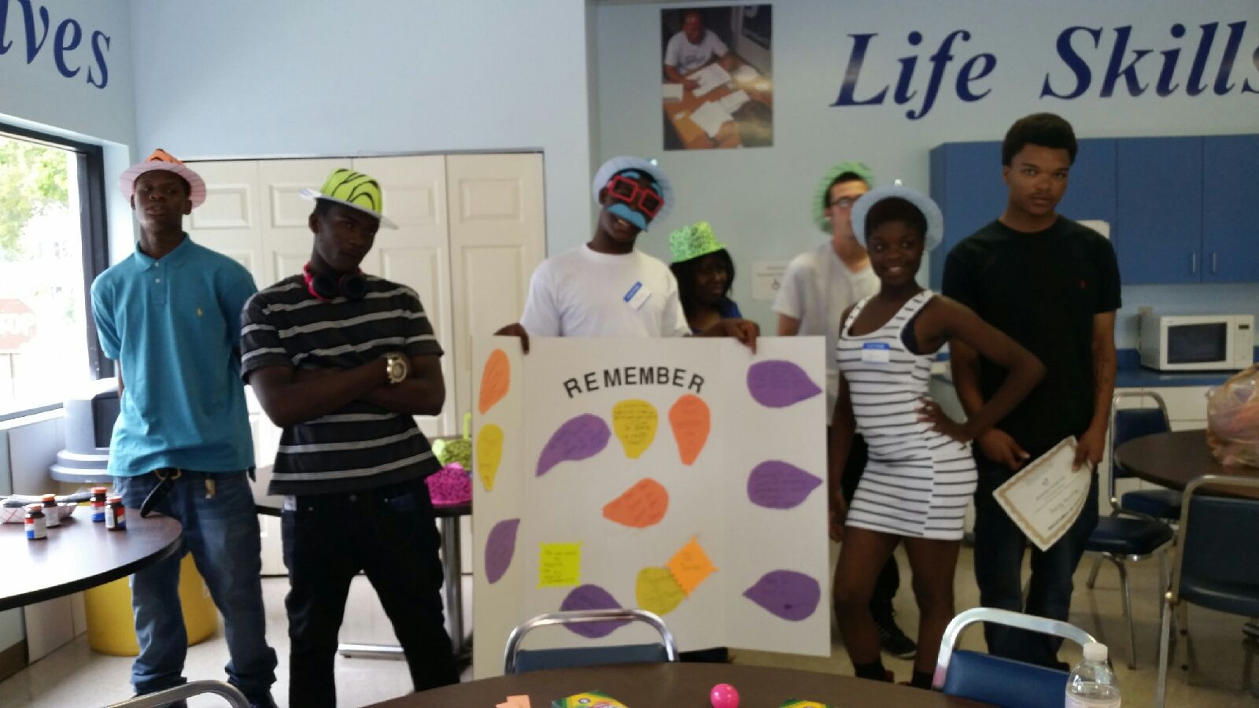
The End….

